Slide 1
How to get an A in Professor Moody’s Class
By: Raashi Maheshwari

Slide 2
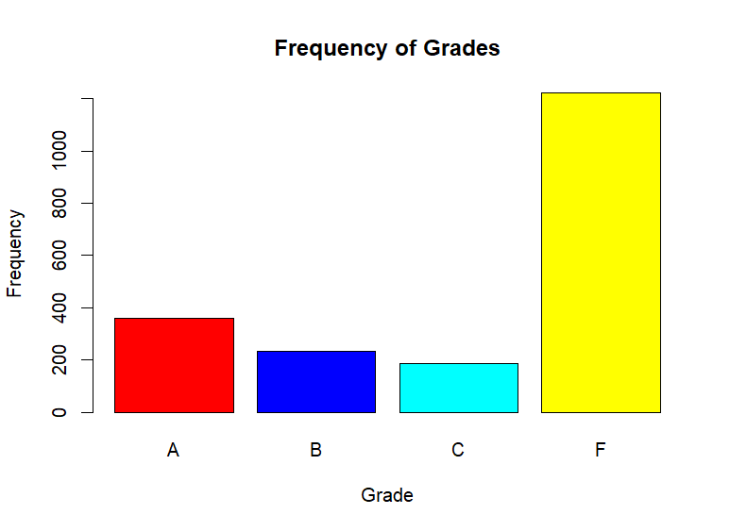
Grades vs Frequency
Not many people ended the class with an A
F seems to be the most common grade
More than half the students failed the class
What factors may have potentially played a role in this?
Notes:
barplot(table(moodyJanuary31b$grade), main='Frequency of Grades', xlab='Grade', ylab='Frequency', col=colors)

Slide 3
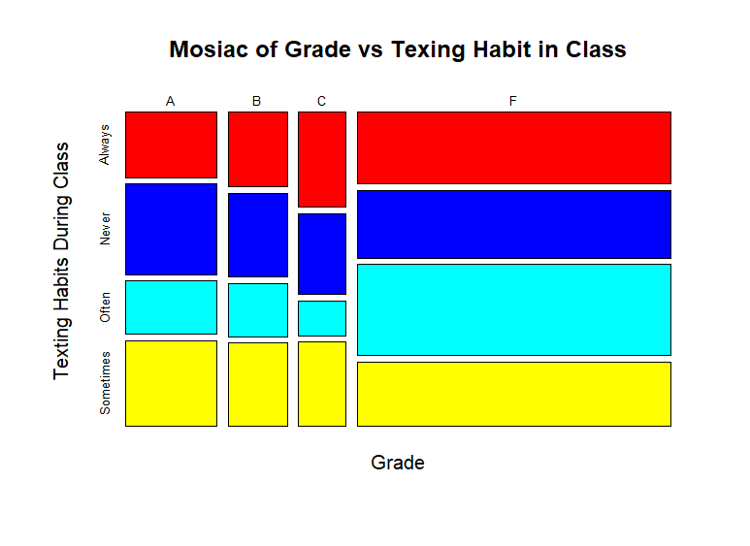
Grades vs Texting Habits
Out of the students who ended the class with F’s, a large portion of them were seen texting “Often” in class
Out of the students who were “Always” texting in class, most of them ended with F’s
Out of the students who ended the class with an A, a large portion of them were “Never” or “Sometimes” texting in Class
Shows that texting “Sometimes” or “Always” in class leads to getting a lower grade, potentially an F
Notes:
mosaicplot(moodyJanuary31b$Grade ~ moodyJanuary31b$Texting, xlab = 'Grade', ylab = 'Texting Habits During Class', main = "Mosiac of Grade vs Texing Habit in Class", col=colors, border="black")

Slide 4
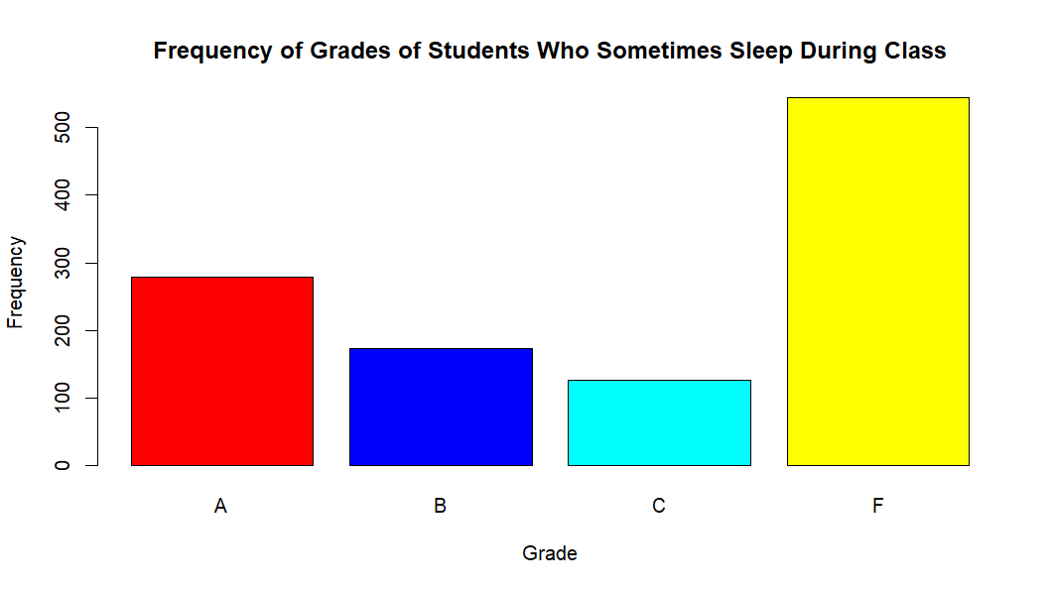
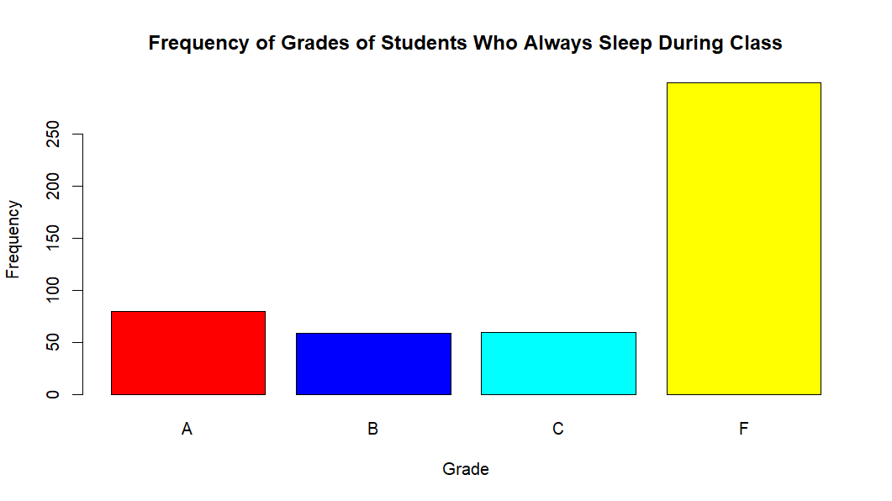
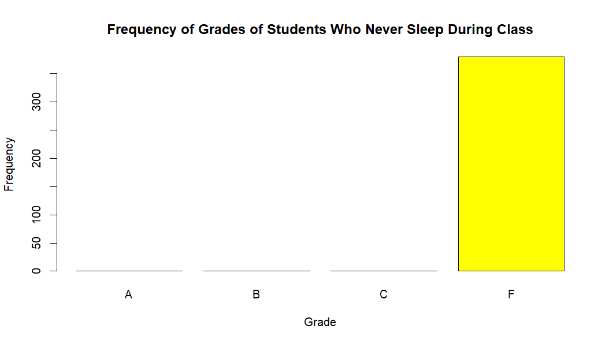
Grade vs. Dozing
Students who “Never” dozed off in class ended the class F’s
Unexpected outcome
Students who “Always” slept during class
Majority of them ended with F’s (expected)
Some ended with A’s, B’s, and C’s
Students who “Sometimes” fell asleep during class
Majority ended with F’s (expected)
Large portion ended with A’s
Some ended with B’s and C’s
Notes:
> never_dozing = subset(moodyJanuary31b, Dozing == "Never")
> barplot(table(never_dozing$Grade), main='Frequency of Grades of Students Who Never Sleep During Class', xlab='Grade', ylab='Frequency', col=colors)
> always_dozing = subset(moodyJanuary31b, Dozing == "Always")
> barplot(table(always_dozing$Grade), main='Frequency of Grades of Students Who Always Sleep During Class', xlab='Grade', ylab='Frequency', col=colors)
> sometimes_dozing = subset(moodyJanuary31b, Dozing == "Sometimes")
> barplot(table(sometimes_dozing$Grade), main='Frequency of Grades of Students Who Sometimes Sleep During Class', xlab='Grade', ylab='Frequency', col=colors)

Slide 5
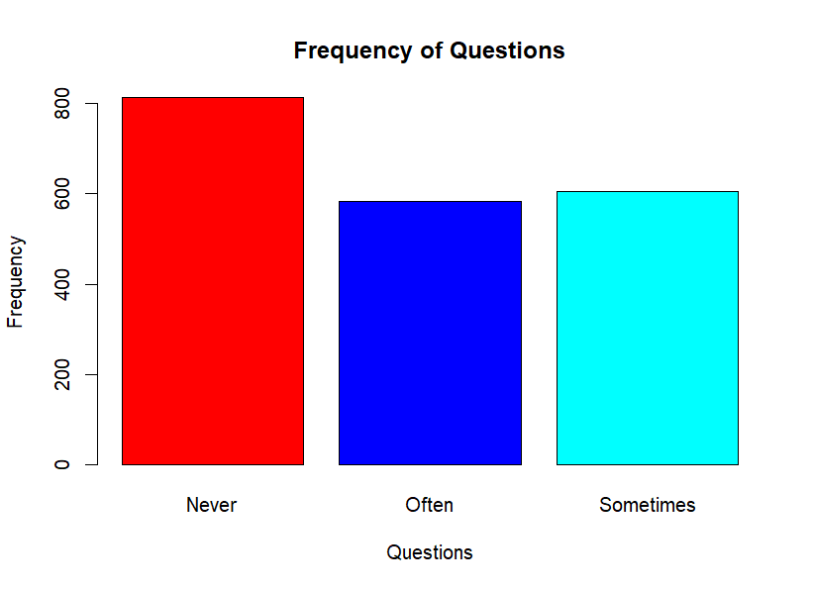
Frequency of Questions
Majority of the students (800+ students) never asked any questions in class
Approximately 600 students “Often” asked questions in class
A little over 600 students “Sometimes” asked questions in class
We will further analyze if this made a difference in their grades
Notes:
barplot(table(moodyJanuary31b$Asking), main='Frequency of Questions', xlab='Questions', ylab='Frequency', col=colors)

Slide 6
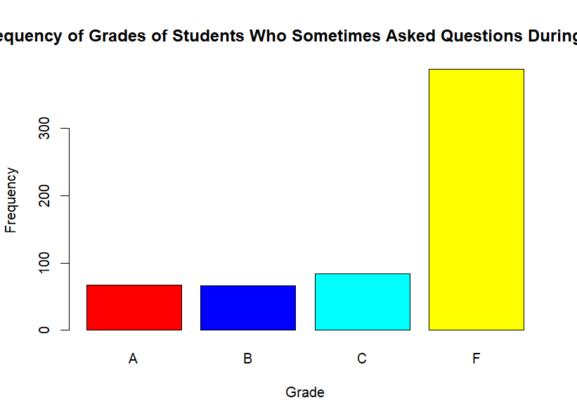
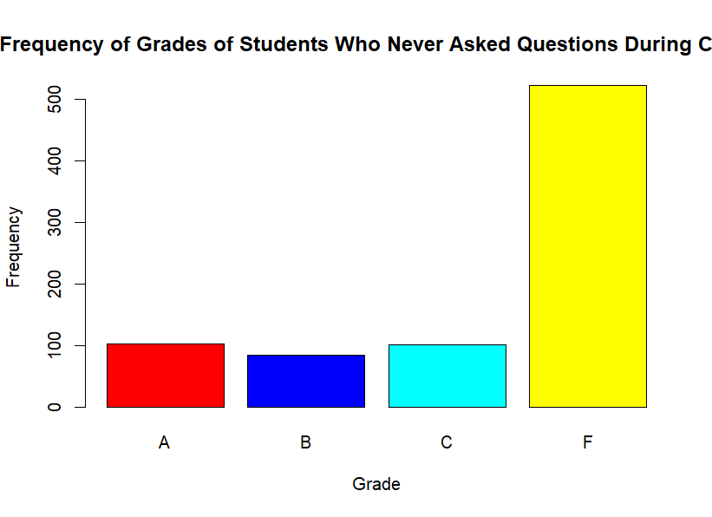
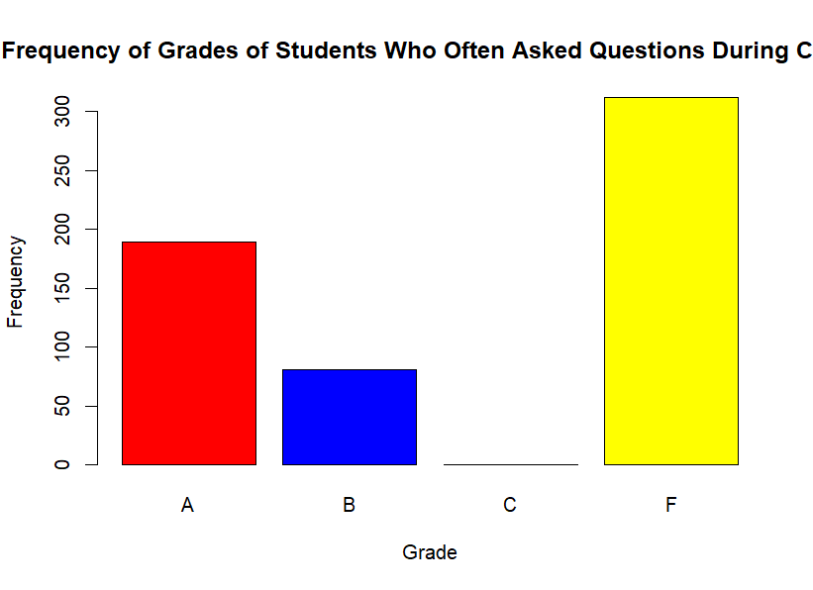
Questions vs. Grade
Students who “Often” asked questions had the most number of A’s
Students who “Often” asked questions were shown to have more A’s and B’s
Students who “Never” asked questions had the most number of F’s in the class
Notes:
> sometimes_questions = subset(moodyJanuary31b, Asking == "Sometimes")
> barplot(table(never_questions$Grade), main='Frequency of Grades of Students Who Never Asked Questions During Class', xlab='Grade', ylab='Frequency', col=colors)
> often_questions = subset(moodyJanuary31b, Asking == "Often")
> barplot(table(sometimes_questions$Grade), main='Frequency of Grades of Students Who Sometimes Asked Questions During Class', xlab='Grade', ylab='Frequency', col=colors)
> often_questions = subset(moodyJanuary31b, Asking == "Often")
> barplot(table(often_questions$Grade), main='Frequency of Grades of Students Who Often Asked Questions During Class', xlab='Grade', ylab='Frequency', col=colors)

Slide 7
Conclusion
Shows that texting “Always” or “Sometimes” in class leads to getting a lower grade, potentially an F
Students should avoid texting while in class
Sleeping in class seemed to get different outcomes
Students who never slept in class still ended up with F’s
Students who always slept in class also ended up with F’s
Shows that sleeping doesn’t really make an impact
Asking questions seemed to have a positive impact, leading to higher number of A’s
Ask questions in class

